Slide 1
Online Retail Segmentation

Slide 2
Problem Statement
To Segment the customers into homogeneous groups, and then design marketing strategies for each of the groups.
Purpose:
Based on the segments, marketing department of the company would like to target its customers better with various ad campaigns, offers, etc.

Slide 3
Hypothesis
Major factors which contributes for segmenting the users and the hypothesis for considering those factors:
Demographics
Customer Age -> Middle aged customers(15-45) purchase more.
City → Tier 1 cities have more orders
Retailer or Wholesaler → Wholesalers purchase more products.
Time/Seasonal features
Day wise Analysis → Weekdays have more order
Month → Festival/Holiday season have higher orders

Slide 4
Hypothesis
Product features
Buying patterns of customer based on product
Top selling Product → People buying a specific type of product
Quantity and type of products sold→ Unique products attracts new customers
Pricing features
Cost of the product → High priced products are ordered less
Above are some of the features and hypothesis which we’ll be checking in our EDA process.

Slide 5
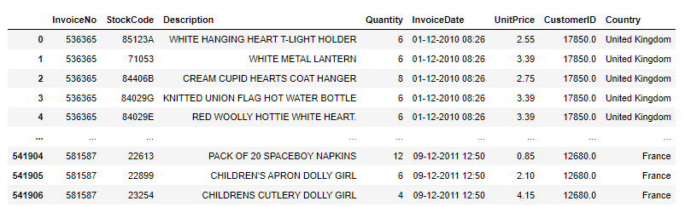
Data Dictionary
The data contains the order details like price,quantity,product name,order time etc.
The dataset contains all the transactions occurring between 01/12/2010 and 09/12/2011 for the company.

Slide 6
EDA insights
5.4 lakhs order have been placed over the period of 2 years, out of which 9288 have been cancelled(1.7%).
91% of the order are from United Kingdom.
From the 5.4 lakh orders, 88% of the orders are placed in 2011.
80% orders are placed during the weekdays, of which Thursday’s record the highest..
November months most orders are placed --> Suggests people order most gift prior to holiday seasons like christmas,new year.
“WHITE HANGING HEART T-LIGHT HOLDER” is the most ordered product.
Both Quantity and Unit price are right skewed, with a mean of 8 and 4 respectively.

Slide 7
Model Preparation
Approaches used for segmentation:
K-means clustering
RFM Analysis
Hierarchical clustering
Features Engineered:
Total Price ---> Denotes the monetary value of the customer.
Count ---> Denotes the frequency of orders placed by the customer.
Recency ---> Denotes the Engagement of the customer.
Date/Time features(day,month,year,hour) ---> Created to analyse the frequency and pattern of orders

Slide 8
Model Preparation
Data preprocessing and cleaning Performed:
Outlier Treatment → Quantity,Unit_Price and recency had a lot of outlier, treated them using the quantile method.
Treating the cancelled order → As they were contributing to negative quantities and was only 1.7% of the data.
Standardisation of variables → As we are using K-means a distance based algorithm, it helps to keep a uniform distribution.

Slide 9
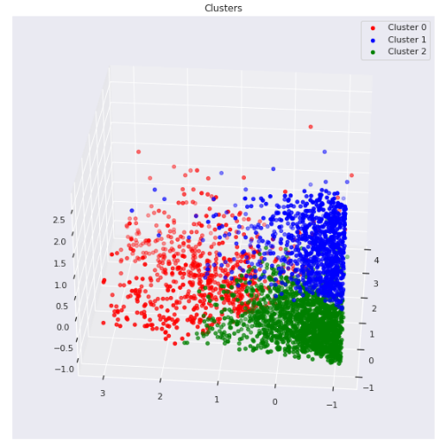
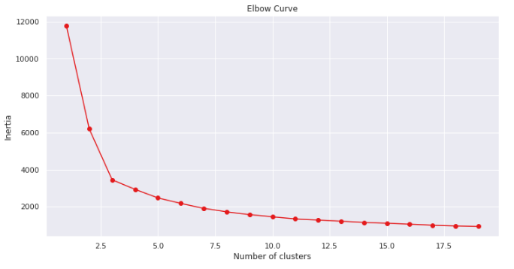
K-means Clustering
K-means yielded better insights than other 2 models, So going ahead with K-means.
Based on the results of Elbow method and silhouette score I have taken number of cluster to be 3.

Slide 10
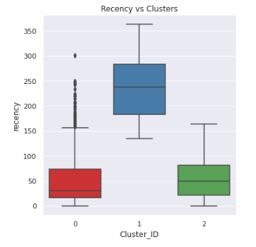
K-means Inference
From the 3 clusters formed below is the inference of each of the clusters.
Recency:
Recency denotes how recent the customer has visited. (lower the better)
Here Cluster 0 has the lowest recency with a mean of 30 days
Cluster 1 has the highest recency value with a mean of 237 days

Slide 11
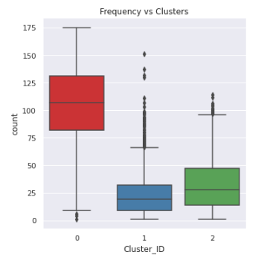
K-means Inference
Frequency:
Frequency denotes times the customer has visited the store.(higher the better)
Cluster 0 has the highest frequency with a mean of 107 times.
Cluster 2 is the second highest with mean of 28.
Cluster 1 has the least frequency of mean 19.

Slide 12
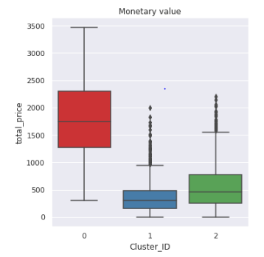
K-means Inference
Monetary:
Higher monetary higher the value yielded by the customer.
Cluster 0 has the highest monetary value of 1740
Cluster 2 has the second highest value of 456
Cluster 1 has the least monetary value of 303

Slide 13
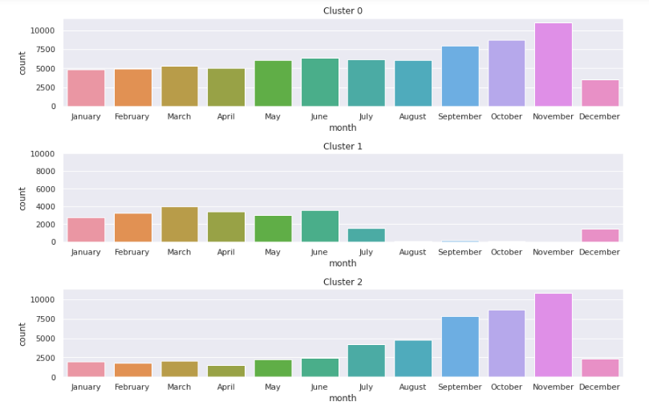
Buying Patterns of Different Clusters
Cluster 0 has placed high orders across months, with the highest on November.
Cluster 1 has very low recency score. These customers aren’t buying much products.
Cluster 2 are seasonal buyers who might have come for festive purchase.

Slide 14
Inference - Cluster 0
Cluster 0: ( Prime Customers) (Low recency/High frequency/High Monetary)
This group of customers are the highest valued customers as they are frequent as well as recent buyers and also have high monetary value from their purchases.
From their buying pattern we can see they order within 1 month, with a monetary value of 1700.
This segment buys product across the months, but is highest during November.
Company should keep doing what they are currently doing for this set of customers.
Additional steps like offering annual membership and reward points for these customers to retain them and also focus on customer satisfaction of this segments by sending out feedback forms.
We can further Analyse these customer demographics like age,city,gender,product needs so we can optimize the company inventory and satisfy their needs with faster delivery.

Slide 15
Inference - Cluster 1
Cluster 1: ( Sleepers Customers) (Low recency/Low frequency/Low Monetary)
This group contains people are the least performers in all three segments.
Their recency is more than 7 months and their monetary value is the least.
This group needs activation, as they aren’t revisiting often. Company can run email campaigns and analyse their CTR’s and response rate.
Either this set of customers are new to store or old customers who aren’t getting what they are looking for. So applying more detailed customer segmentation on this segment to understand why they aren’t revisiting and better understanding their needs.

Slide 16
Inference - Cluster 2
Cluster 2: ( Sub-prime Customers) (Medium recency/Medium frequency/Medium Monetary)
This is the second best group of the three clusters.
This group of customers order between 2 months, but their monetary value is very low when compared to cluster 1.
These segment have a recency of 2 months. But their frequency is low. So company can strategize to improve the frequency by sending personalized offer emails to these segments and make them order products.
Giving out coupons which can be redeemed on next purchase will make them to buy more frequently.

Slide 17
Conclusion
There are three customer segmentations.
Cluster 0 are the best in all three parameters, company should mainly focus on retention and customer satisfaction of this segments.
Cluster 2 have good recency value and low frequency, so creating personalised offers/giving redeem on next purchase coupons to this segment to make them visit again and buy more.
Cluster 1 are the sleepers segment who aren’t engaging much, so improving their engagement by running campaigns at the same time keeping the amount spent as this segment isn’t yielding much monetary.

